Slide 1
Code Generation
Chapter 8

Slide 2
Code Generation
Final phase of our compiler model
Intermediate Code
Code Generator
Semantically Equivalent
Target Program
Relevant Symbol-Table
Information

Slide 3
Important Issues of Code Generation
Should produce correct Target Program
Preserving Semantic meaning of Source Program
Should produce high quality Target Program
Efficient use of available resources of target program
Should run efficiently

Slide 4
Code Generation & Optimization
To produce optimized target program, compiler may include an optimization phase prior to the generation
Optimizer maps the IR into IR from which efficient code can be generated
Front End
IR
Optimizer
IR
Code Generator
Source Program
Target program
Position of a Code Generator

Slide 5
Issue 1: Input to Code Generator
The intermediate representation (IR) of the source program.
Three address representation
Quadruples
Triples
Indirect triples
Virtual machine representation
Byte codes and stack-machine code
Linear representation
Postfix notations
Graphical representation
Syntax tree and DAG
We consider Three address representation.

Slide 6
Issue 1: Input to Code Generator
Code generator assumes that
Front end has scanned, parsed, translated the source program into a relatively low level IR
All syntactic and static semantic errors have been detected
The necessary type checking has taken place
Type conversion operators have been inserted

Slide 7
Issue 2: Target Machine and Program
Instruction set architecture of the target machine has significant impact on code generation
The most common machine architectures are:
RISC
Many Registers
Three address instructions
Simple addressing modes
Relatively simple instruction – set architecture
CISC
Few registers
Two address instructions
Variety of addressing modes
Variable length instructions
Stack Based
For example, JVM

Slide 8
Issue 2: Target Machine and Program (2)
Absolute machine code
It can be placed in a fixed location in memory
Can immediately be executed
Relocatable machine – language program
Allows subprograms to be compiled separately
Linker : links a set of Relocatable object modules together
Loader: load them in memory
Assembly language
Easier to generate using of macro and symbolic instruction
However, requires assembly step after code generation

Slide 9
Issue 3: Instruction Selection
The code generator must map the IR program into a code sequence that can be executed by the machine
The complexity of performing the mapping is determined by factors such as
The level of the IR
The nature of the ISA (instruction-set architecture)
The desired quality of the generated code
From a set of instructions, we need to select instructions such that
Generated code is correct and efficient
Instruction selection is easy if we don’t care efficiency
For each three address statement, we can design a code skeleton that defines the target code for that construct

Slide 10

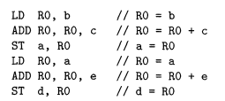

Issue 3: Instruction Selection
Instruction selection for three address statement of form x = y + z can be:
But can produce redundant loads and stores
Three address statements
Translated Code

Slide 11

Issue 3: Instruction Selection
On most machines, a given IR can be translated in many different ways
Some may be efficient, some not
Example statement: a = a + 1
If the target machine has an INC instruction, then we have two ways to implement for that machine
(ii)
(i)

Slide 12
Issue 4: Register Allocation
Registers are the fastest computational unit but we do not have enough of them
Values not held in register need to reside in memory
Instruction involving register operands are shorter and faster
Use of registers is subdivided into two subproblems –
Register allocation: select the set of variables that will reside in registers at each point in the program
Register assignment: we pick a register that a variable will reside in.
Finding an optimal assignment of registers to variables is difficult
NP-complete

Slide 13
Issue 5: Evaluation Order
Evaluation order can affect the efficiency of the target code
Some ordering requires fewer registers to hold intermediate results
Finding the best order is difficult
NP-complete

Slide 14
Basic Blocks & Flow Graphs
Flow graph is a graphical representation of Intermediate code (IR)
Helps in Code Generation
Better job in Register Allocation
Better job in Instruction Selection

Slide 15
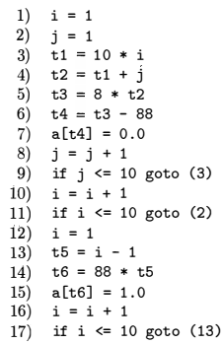
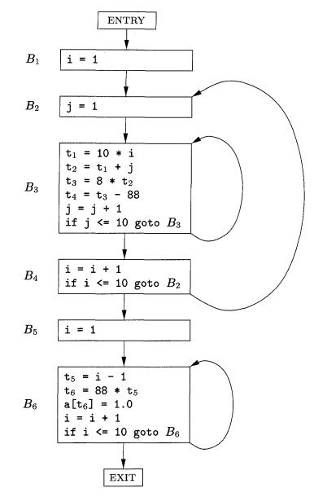
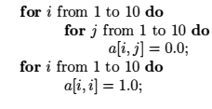
Basic Blocks & Flow Graphs
Source Program
Three Address Code
Flow Graph

Slide 16
Constructing Flow Graphs
Partition the intermediate code into basic blocks, which are maximal sequences of consecutive Three-Address instructions with the properties –
The flow of control can only enter the basic block through the first instruction in the block
There are no jumps into the middle of the bock
Control will leave the block without halting or branching
Except possibly at the last instruction in the block
The basic blocks become the nodes of a flow graph
Edges indicate which block can follow which other blocks

Slide 17
Constructing Basic Blocks
Algorithm: Partitioning Three-Address Code into Basic Blocks
Input: A sequence of Three-Address Code
Output: A list of basic blocks where each instruction is assigned to exactly one block
Method:
Determine those instructions in the intermediate code that are the first instructions in some basic blocks – leaders
The first instruction in a sequence is a leader
Any instruction that is the target of a branch is a leader
Any instruction that follows a branch is a leader
For each leader, basic block consists codes upto next leader or end

Slide 18
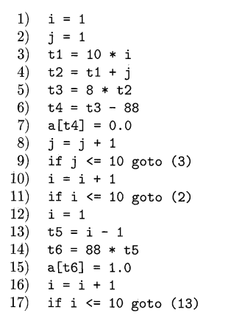
Constructing Basic Blocks
Method:
Determine those instructions in the intermediate code that are the first instructions in some basic blocks – leaders
The first instruction in a sequence is a leader
Any instruction that is the target of a branch is a leader
Any instruction that follows a branch is a leader
For each leader, basic block consists codes upto next leader or end
Leader (Rule 1)
B₁
B₂
Leader (Rule 2)
B₃
Leader (Rule 2)
Leader (Rule 3)
B₄
B₅
Leader (Rule 3)
B₆
Leader (Rule 2)

Slide 19
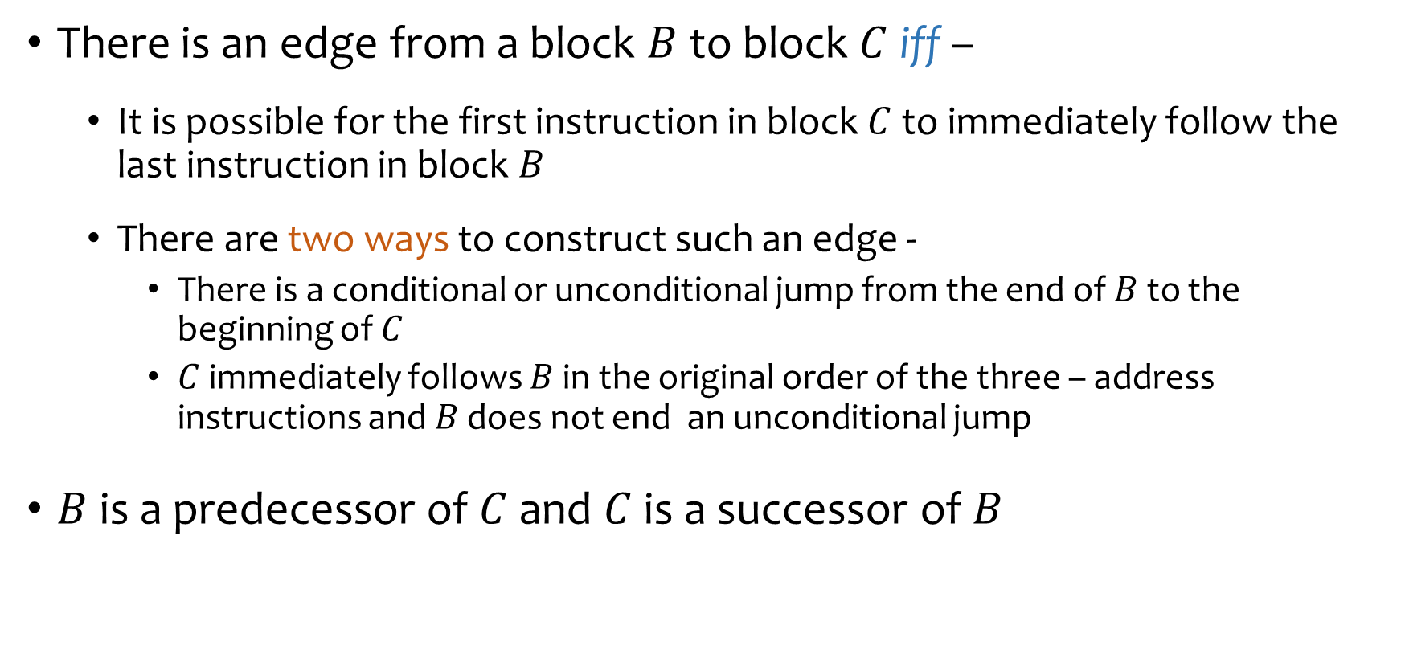
Flow Graphs
There is an edge from a block $B$ to block $C$iff –
It is possible for the first instruction in block $C$ to immediately follow the last instruction in block $B$
There are two ways to construct such an edge -
There is a conditional or unconditional jump from the end of $B$ to the beginning of $C$
$C$ immediately follows $B$ in the original order of the three – address instructions and $B$ does not end an unconditional jump
$B$ is a predecessor of $C$ and $C$ is a successor of $B$

Slide 20
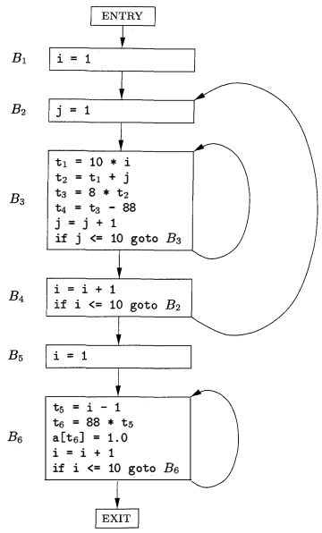
Flow Graphs
B₁
B₂
B₃
B₄
B₅
B₆
Flow Graph

Slide 21
Representation of Flow Graphs
Jumps to instruction numbers or labels are replaced by jumps to basic blocks
Every conditional or unconditional jump is to the leader of some basic block, it is to this block this jump will now refer
After constructing the flow graph it is common to make substantial changes to the instructions in the various basic blocks
If jumps were to instructions, it would cause to fix the targets with each change
Flow graphs can be represented by any of the data structures used for graph
The content of nodes can be represented by
pointer to the leader in the array of three address instructions together with count of the number of instructions or a second pointer to the last instruction.
It is better to maintain a linked list as the number of instructions in a basic block are changed frequently.

Slide 22
Loops
Programming-language constructs like while-statements and for-statements naturally gives rise to loops in programs.
Virtually every program spends most of its time in executing its loops
It is important for a compiler to generate good code for loops
Many code transformations depend upon the identification of “loops” in a flow graph

Slide 23
Loops
A set of nodes L in the flow graph is a loop if L contains a node e called the loop entry, such that
e is not ENTRY, the entry of the entire flow graph
No node in L besides e has a predecessor outside L, i.e., every path from ENTRY to any node in L goes through e
Every node in L has a nonempty path, completely withing L, to e
Example: Loops in the flow graph on the right are -
B₃ by itself
B₆ by itself
{B₂, B₃, B₄}

Slide 24
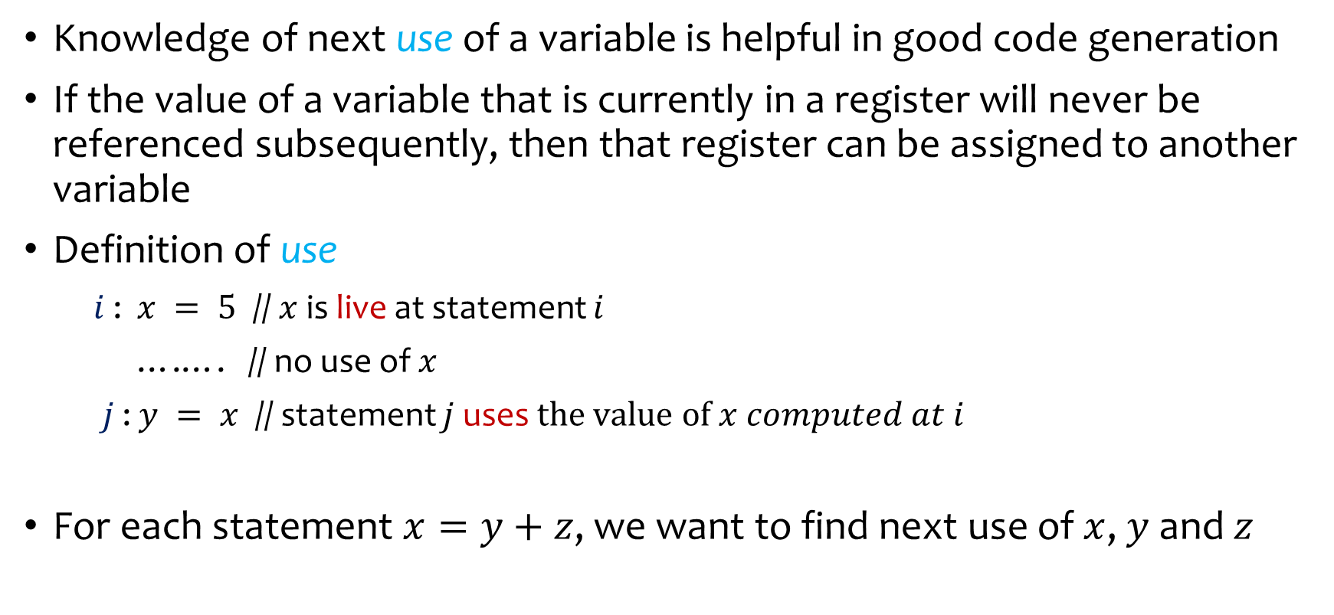
Liveliness & Next-Use Information
Knowledge of next use of a variable is helpful in good code generation
If the value of a variable that is currently in a register will never be referenced subsequently, then that register can be assigned to another variable
Definition of use
$i$ : $x = 5$ // $x$ is live at statement $i$
….…. // no use of $x$
$j$ : $y = x$ // statement $j$ uses $the value of x computed at i$
For each statement $x=y+z$, we want to find next use of $x$, $y$ and $z$

Slide 25
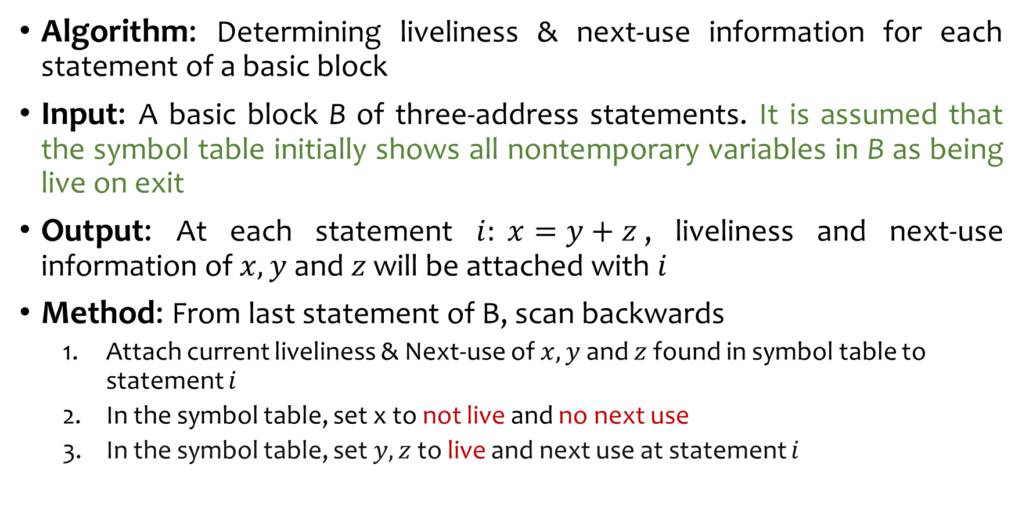
Liveliness & Next-Use Information
Algorithm: Determining liveliness & next-use information for each statement of a basic block
Input: A basic block B of three-address statements. It is assumed that the symbol table initially shows all nontemporary variables in B as being live on exit
Output: At each statement $i: x=y+z$, liveliness and next-use information of $x,y$ and $z$ will be attached with $i$
Method: From last statement of B, scan backwards
Attach current liveliness & Next-use of $x,y$ and $z$ found in symbol table to statement $i$
In the symbol table, set x to not live and no next use
In the symbol table, set $y,z$ to live and next use at statement $i$

Slide 26
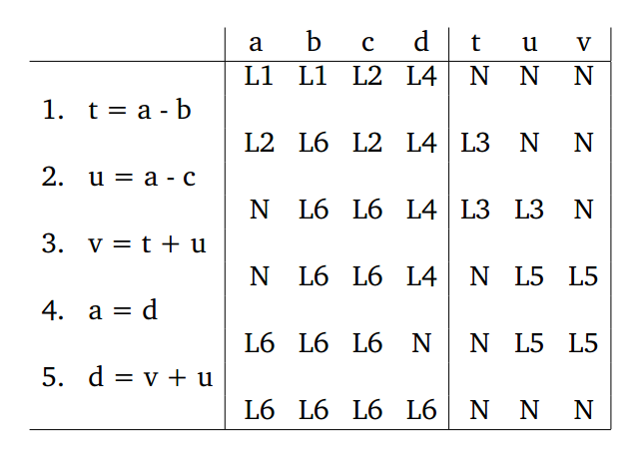
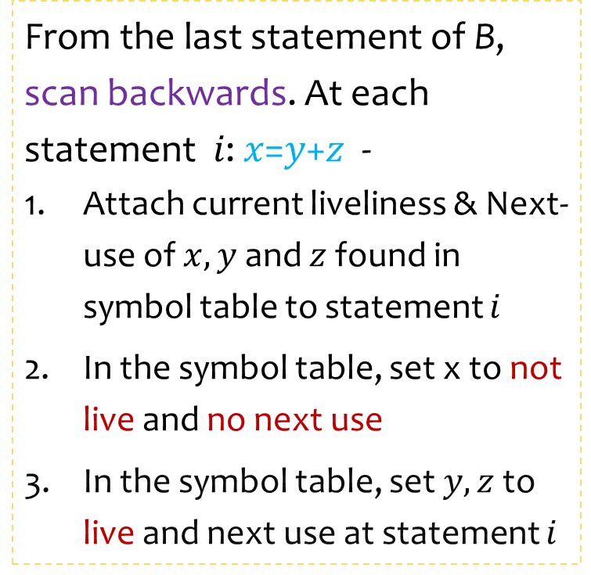
Liveliness & Next-Use Information
From the last statement of B, scan backwards. At each statement 𝑖: 𝑥=𝑦+𝑧 -
Attach current liveliness & Next-use of $x,y$ and $z$ found in symbol table to statement $i$
In the symbol table, set x to not live and no next use
In the symbol table, set $y,z$ to live and next use at statement $i$
Basic Block
Symbol Table
__
L3
__
L2
__
L6
__
L3
__
N
__
L6
__
L5
__
N
__
L5
__
L6
__
N
__
L6
__
N
__
N
Notes:
What if we add another instruction at the top v = a + b

Slide 27
Optimization of Basic Blocks
Optimization within each basic block is also called local optimization
Some code improving transformations are -
Common Subexpression Elimination
Dead Code Elimination
Reordering of statements to reduce the time of a temporary variable in a register
Simplify Algebraic Computation

Slide 28

DAG representation of Basic Blocks
Many important techniques for local optimization begin by transforming a basic block into a DAG
We can construct DAG for a basic block as follows
There is a node in the DAG for each of the initial values of the variables appearing in the basic block
There is a node N associated with each statement s within the block. The children of N are those nodes corresponding to statements that are the last definitions, prior to s, of the operands used by s
Node N is labeled by the operator applied at s, and also attached to N is the list of variables for which it is the last definition within the block
Certain nodes are designated output nodes. These are the nodes whose variables that are live on exit from the block
c
+
-
b
,d
+
a
d₀
b₀
c₀

Slide 29
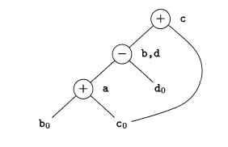

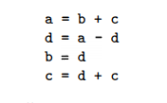
Eliminate Local Common Subexpressions
b is not live on exit
b is live on exit

Slide 30
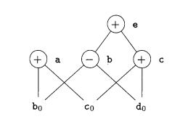

Finding Local Common Subexpressions
Another Example:
What will happen in this case?
DAG method will fail to recognize detect common subexpression of 1st and 4th instruction

Slide 31
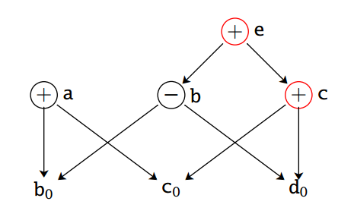
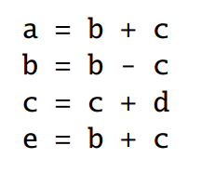
Dead Code Elimination
Eliminate instructions that compute values that are never used
Delete the nodes with no ancestor and no attached live variables from the DAG
Assuming e and c are not live on exit

Slide 32

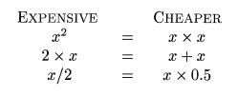
Use of Algebraic Identities
Apply algebraic identities to eliminate computation
Local reduction in strength
Constant Folding by evaluating constant expressions at compile time
Example: replace 2*3.14 by 6.28

Slide 33
Use of Algebraic Identities
Commutativity with local common subexpression
Associativity with composite expression
a = x*y
b = y*x
a = x*y
b = a
Assuming t is not live on exit
a = b+c
t = c+d
b = t+b
a = b+c
b = c+d+b
a = b+c
b = a+d

Slide 34
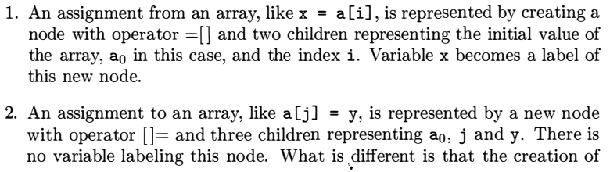

Representation of Array References

Slide 35


Representation of Array References
=[]
z
killed
=[]
x
[]=
a₀
i₀
j₀
y₀
[]=
killed
=[]
x
+
b
12
a₀
i₀
j₀
y₀

Slide 36
Reassembling Basic Blocks From DAGs
After performing optimizations on DAG, we need to reconstitute the three-address code for the basic block from which the DAG was built
For each node, that has one or more attached variables, a three-address statement is constructed that computes the value of one of those variables
Select the variable that is live on exit from the block
However, if global-live variable information is not available, all variables except the temporaries are to be computed
If a node has more than one live variable attached, then introduce copy statement to give the correct values to each of these variables.

Slide 37
Reassembling Basic Blocks From DAGs(2)
While reconstructing a basic block from the DAG, the order of instructions should also be correctly maintained conforming to the following rules -
A node’s values cannot be computed until the value for each of its children has been computed
Assignments to an array must follow all previous assignments to, or evaluations from, the same array, according to the order of these instructions in the original basic block
Evaluations of array elements must follow any previous (according to the original block) assignments to the same array. The only permutation allowed is that two evaluations from the same array may be done in either order, as long as neither crosses over an assignment to that array
Any use of variable must follow all previous (according to the original block) procedure calls or indirect assignments through a pointer
Any procedure call or indirect assignments through a pointer must follow all previous (according to the original block) evaluation of any variable

Slide 38
Switch to Machine Independent Optimizations (Chapter 9)

Slide 39
Back to Code Generation

Slide 40
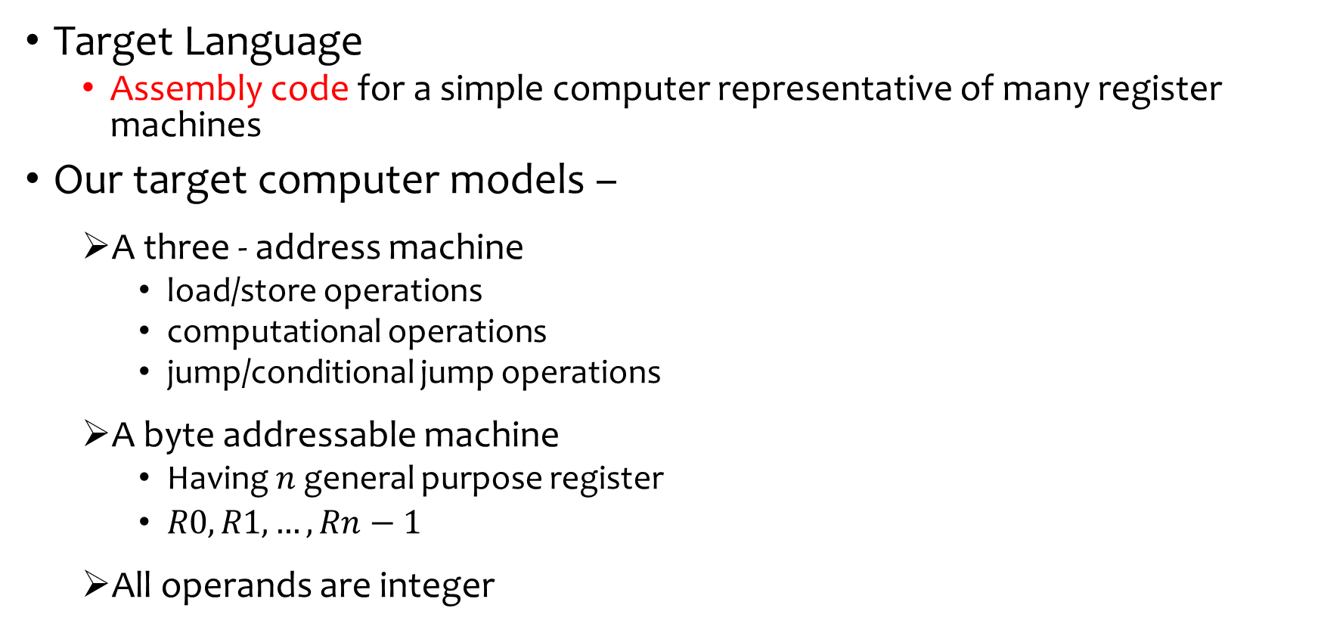
A Simple Target Machine Model
Target Language
Assembly code for a simple computer representative of many register machines
Our target computer models –
A three - address machine
load/store operations
computational operations
jump/conditional jump operations
A byte addressable machine
Having $n$ general purpose register
$R0, R1, …, Rn−1$
All operands are integer

Slide 41
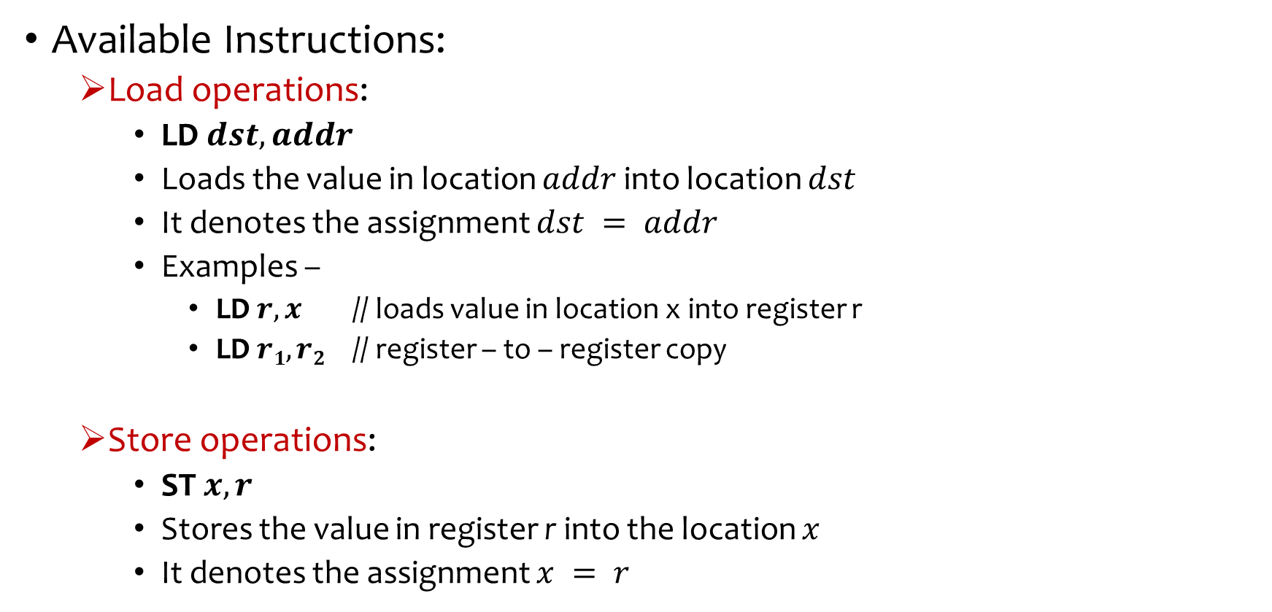
A Simple Target Machine Model(2)
Available Instructions:
Load operations:
LD $dst, addr$
Loads the value in location $addr$ into location $dst$
It denotes the assignment $dst = addr$
Examples –
LD $r, x$ // loads value in location x into register r
LD $r1, r2$ // register – to – register copy
Store operations:
ST $x, r$
Stores the value in register r into the location $x$
It denotes the assignment $x = r$

Slide 42
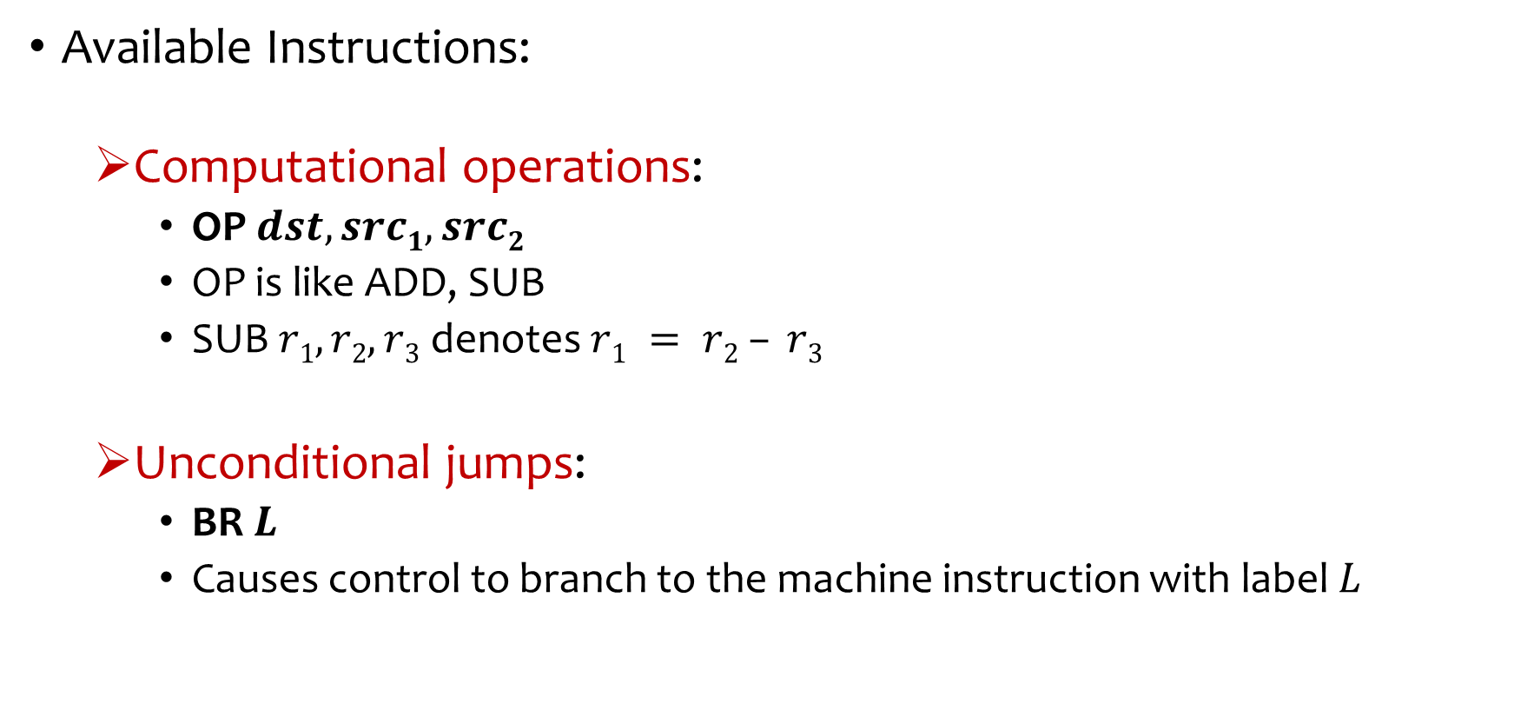
A Simple Target Machine Model
Available Instructions:
Computational operations:
OP $dst, src1, src2$
OP is like ADD, SUB
SUB $r1, r2, r3$ denotes $r1 = r2 – r3$
Unconditional jumps:
BR $L$
Causes control to branch to the machine instruction with label $L$

Slide 43
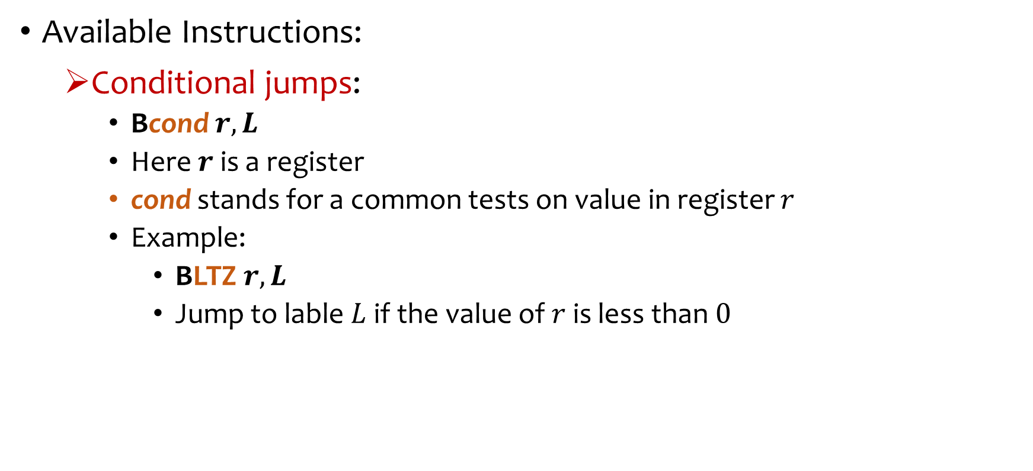
A Simple Target Machine Model
Available Instructions:
Conditional jumps:
Bcond $r, L$
Here $r$ is a register
cond stands for a common tests on value in register $r$
Example:
BLTZ $r,L$
Jump to lable$L$ if the value of $r$ is less than $0$

Slide 44
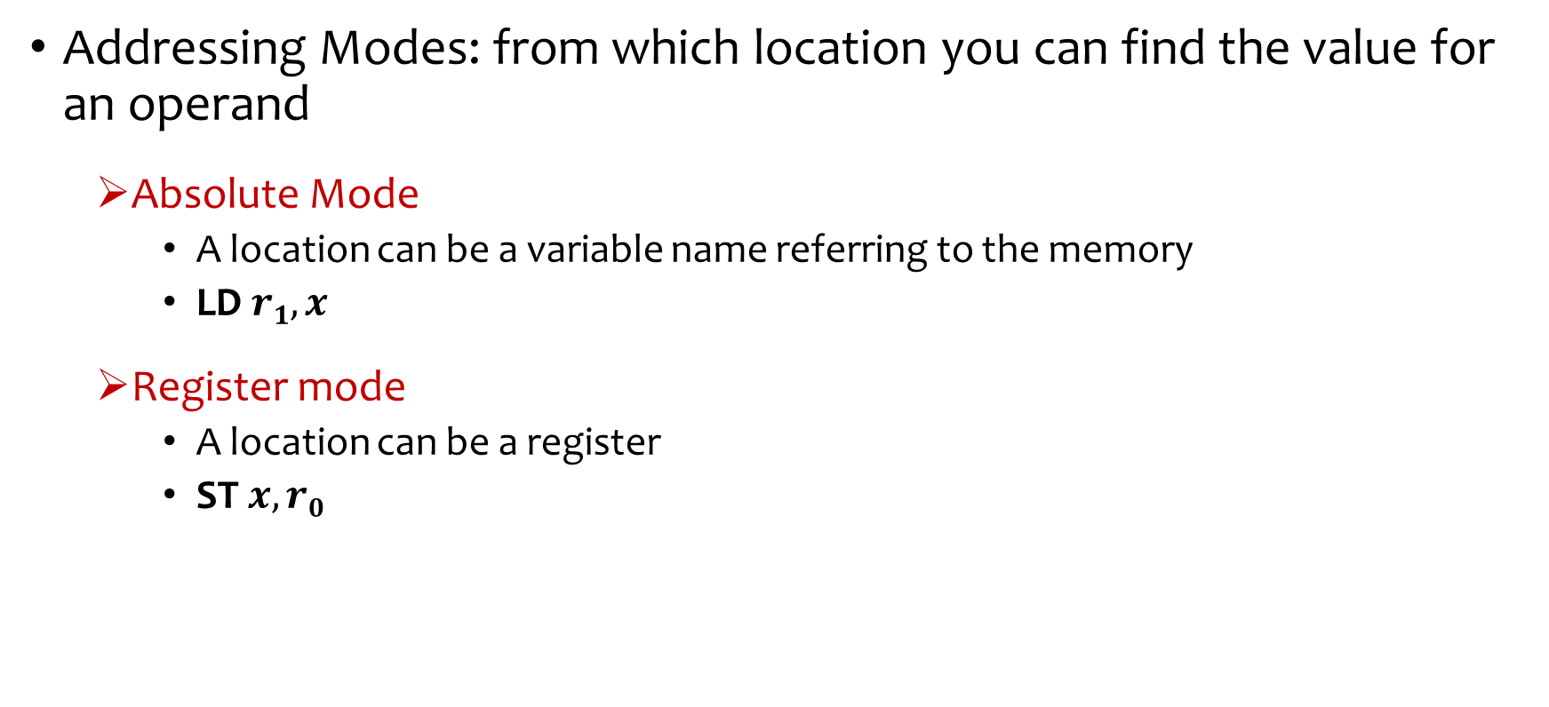
Addressing Modes
Addressing Modes: from which location you can find the value for an operand
Absolute Mode
A location can be a variable name referring to the memory
LD $r1, x$
Register mode
A location can be a register
ST $x, r0$

Slide 45
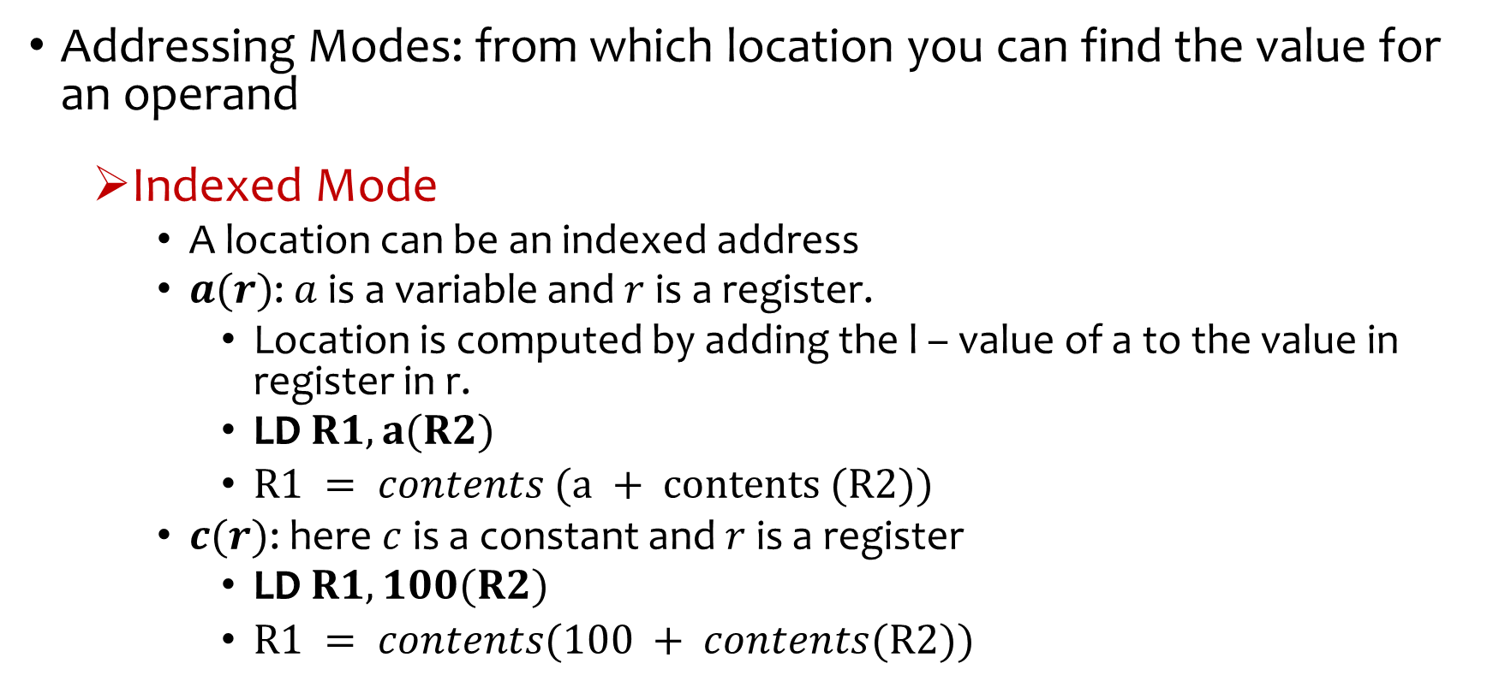
Addressing Modes
Addressing Modes: from which location you can find the value for an operand
Indexed Mode
A location can be an indexed address
$a(r)$: $a$ is a variable and $r$ is a register.
Location is computed by adding the l – value of a to the value in register in r.
LD $R1, a(R2)$
$R1 = contents (a + contents (R2))$
$c(r)$: here $c$ is a constant and $r$ is a register
LD $R1, 100(R2)$
$R1 = contents(100 + contents(R2))$

Slide 46
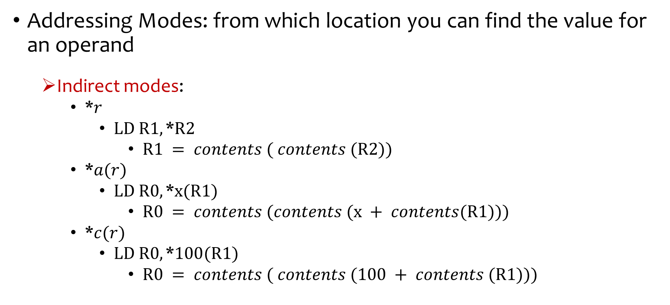
Addressing Modes
Addressing Modes: from which location you can find the value for an operand
Indirect modes:
*$r$
$LD R1,\text{∗}R2$
$R1 = contents ( contents (R2))$
*$a(r)$
$LD R0,\text{∗}x(R1)$
$R0 = contents (contents (x + contents(R1)))$
*$c(r)$
$LD R0,\text{∗}100(R1)$
$R0 = contents ( contents (100 + contents (R1)))$

Slide 47
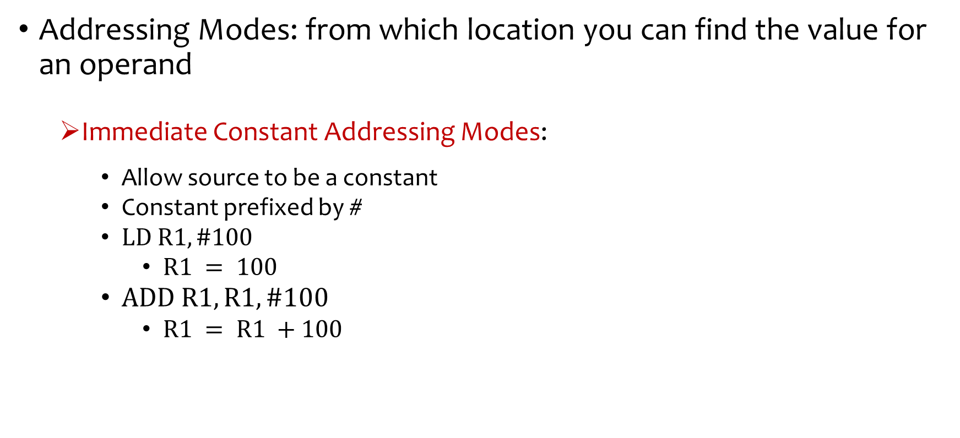
Addressing Modes
Addressing Modes: from which location you can find the value for an operand
Immediate Constant Addressing Modes:
Allow source to be a constant
Constant prefixed by #
$LD R1, \#100$
$R1 = 100$
$ADD R1, R1, \#100$
$R1 = R1 +100$

Slide 48
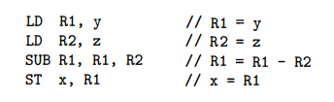

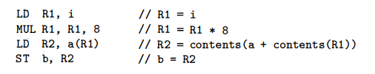
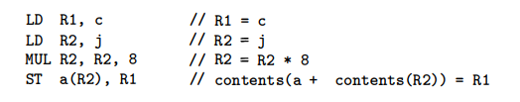
Statement-wise Code Generation
IR (TAC)
Target Code

Slide 49



Statement-wise Code Generation
IR (TAC)
Target Code

Slide 50
Program Cost
A cost is often associated with compiling and running program
Common cost measure may be-
Compilation time
Size of the target program
Running-time of the target program
Power consumption of the target program
We assume, the cost of a target-language program on a given input is the sum of the costs of the individual instructions executed when the program is run on that input.

Slide 51
Instruction Cost
Simple model for instruction cost
Cost of an instruction = One plus cost for the addressing modes.
Addressing modes –
involving registers have zero additional cost
involving a memory location / constant have an additional cost
Since such operands have to be stored in the words following the instruction

Slide 52
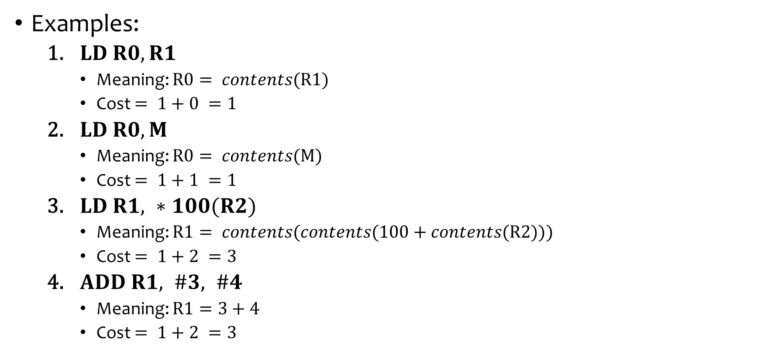
Instruction Cost
Examples:
$LD R0, R1$
Meaning: $R0= contents(R1)$
Cost $= 1+0 =1$
$LD R0, M$
Meaning: $R0= contents(M)$
Cost $= 1+1 =1$
$LD R1, ∗100(R2)$
Meaning: $R1= contents(contents(100+contents(R2)))$
Cost $= 1+2 =3$
$ADD R1, \#3, \#4$
Meaning: $R1=3+4$
Cost $= 1+2 =3$

Slide 53
Uses of Registers
One of the primary issues during code generation is deciding how to use registers to best advantage
There are four principal uses of registers
In most machine architectures, some or all of the operands of an operation must be in registers
Registers make good temporaries –
Hold the result of a subexpression while evaluating a larger expression
Hold a variable that is used only within a single basic block
Registers are used to hold (global) values that are computed in one basic block and used in other blocks, for example a loop index
Registers are often used to help with run-time storage management, for example maintaining stack pointers and top of the stack

Slide 54
Simple Code-Generation Algorithm
Generates code for a single basic block
Assumes -
the basic block has already been optimized
some set of registers are available to hold values within blocks
there is exactly one machine instruction for each operator that accepts the operands from registers and stores the result in a registers
Consider each three-address instruction in turn
Keep track of what values are in what registers
Avoid generating unnecessary loads and stores

Slide 55
Register and Address Descriptors
Register Descriptor
One for each register
Keeps track of the variable names whose current value is in the register
Initially all are set to empty
Address Descriptor
One for each program variable
Keeps track of the location or locations where the current value of that variable can be found
Locations can be a register, a memory address, a stack location
Can be a set of more than one of the above
Can be stored in the symbol table entry of the variable

Slide 56
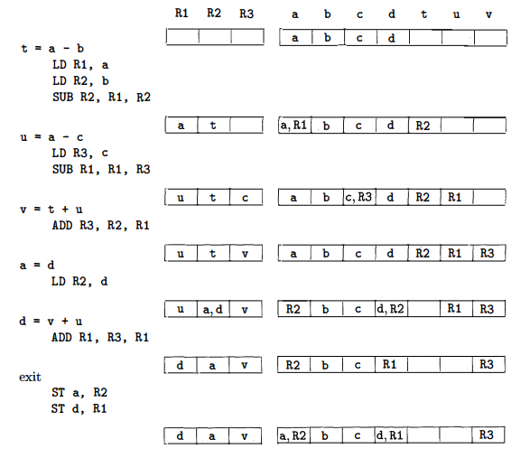
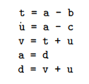
An Example of Code-Generation
IR (TAC)
Gen. Code
getReg(I)
Register Descriptors
Address Descriptors
{R2, R1, R2}
{R1, R1, R3}

Slide 57
An Example of Code-Generation
IR (TAC)
Gen. Code
getReg(I)
Register Descriptors
Address Descriptors
{R3, R2, R1}
{R2, R2}
{R1, R3, R1}

Slide 58
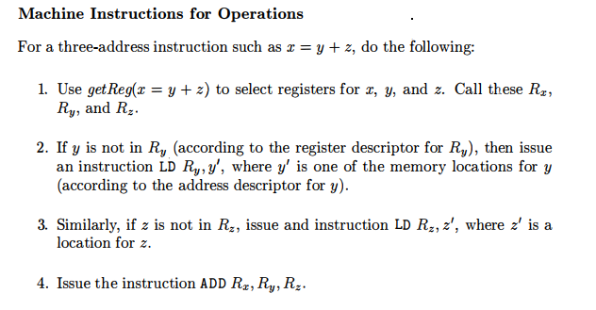
The Code-Generation Algorithm
Machine instructions for operations

Slide 59
The Code-Generation Algorithm
Machine instructions for Copy Statements (of the form x=y)
Assumes getReg(I) will always generate the same register for x and y
If y is not already in Ry, then generate instruction LD Ry, y
Else do nothing
Ending the basic block
Variables used in a block may wind up with their only location being a register
For temporary variables within a block, do nothing
For each variable x that is live on exit from the block, generate instruction
ST x, R where R is the register that stores x’s value

Slide 60
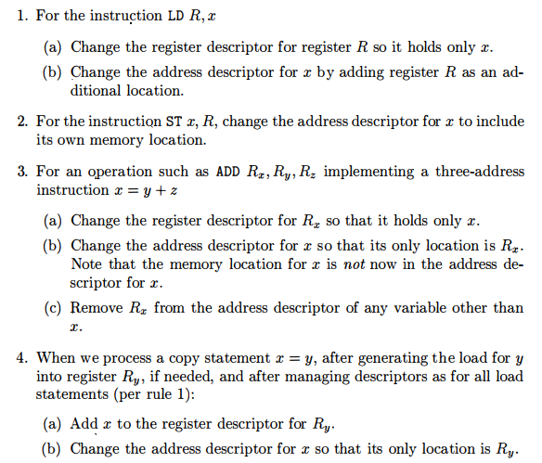
Managing Register and Address Descriptors

Slide 61
Managing Register and Address Descriptors

Slide 62
Design of Function getReg(I)
For variable y ( and z as well) in the expression x=y+z
If y is currently in a register, pick that register as Ry
Else if y is not in a register and there are empty registers, pick an empty register as Ry
Else if y is not in a register and there are no empty registers, then
- for each register R
- For each variable v that are in R
- If v is somewhere besides R (check from address descriptor), pick R
- Else if v is x, and x is not one of the other operands (z), pick R
- Else if v is not used later, pick R
- Else generate a store instruction ST v, R; called a spill
Since R may hold several variables at the moment, calculate R’s score as total number of spills required for all its variables
- pick the register R with lowest score as Ry

Slide 63
Design of Function getReg(I)
For variable x in the expression x=y+z
- The issues and options are almost as for y, except for the following differences
- A register that holds only x is always an acceptable choice for R_{x}
- holds true even if x is one of y and z
- If y is not used after instruction I and R_{y} holds only y after being loaded, if necessary then pick R_{y} as R_{x}
- similar option holds regarding z and R_{z}
- If I is a copy instruction (x=y), always choose R_{y} as R_{x}

Slide 64
Global Register Allocation (See the pdf titled Global Register Allocation)

Slide 65
Related References
https://web.stanford.edu/class/cs143/lectures/lecture17.pdf
http://web.cs.ucla.edu/~palsberg/course/cs132/linearscan.pdf
https://user.it.uu.se/~kostis/Teaching/KT1-11/Slides/lecture16.pdf
https://en.wikipedia.org/wiki/Register_allocation

Slide 66
An Example From GCC
Target Code
(MIPS64 gcc 5.4 without O1 switch)
Target Code
(MIPS64 gcc 5.4 with O1 switch)
Source Code
int a, b, c, d, e, f, g;
int main(){
a=b*c;
b=1;
return 0;
}
… … …
ld $2,%got_disp(b)($4)
lw $3,0($2)
ld $2,%got_disp(c)($4)
lw $2,0($2)
mult $3,$2
mflo $3
ld $2,%got_disp(a)($4)
sw $3,0($2)
ld $2,%got_disp(b)($4)
li $3,1 # 0x1
sw $3,0($2)
… … …
… … …
ld $3,%got_disp(b)($5)
lw $2,0($3)
ld $4,%got_disp(c)($5)
lw $4,0($4)
mul $2,$2,$4
ld $4,%got_disp(a)($5)
sw $2,0($4)
li $2,1 # 0x1
sw $2,0($3)
… … …
Multiple loads of variable b
All variables are loaded only once

Slide 67
Peephole Optimization
Peephole
- a small sliding window of target instructions
Replace instructions in peephole with shorter and faster sequence
Can be applied on Intermediate code or assembly code
Repeated passes result in better optimization

Slide 68

Peephole Optimization
Redundant-instruction elimination

Slide 69



Peephole Optimization
Eliminating unreachable code
Eliminating jump over jumps
If debug is initialized to zero, then using constant propagation
Eliminating unreachable code

Slide 70






Peephole Optimization
Flow-of-control optimization

Slide 71

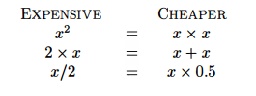
Peephole Optimization
Algebraic Simplification
Reduction in strength

Slide 72
Peephole Optimization
Use of machine idioms
x= x + 1
x++

Slide 73
Reference
Compilers: Principles, Techniques, & Tools, by
Alfred B. Aho, Monica S. Lam, Ravi Sethi, Jeffrey D. Ullman
Chapter 8
8.1
8.2
8.3
8.4
8.5
8.6
8.7

Slide 74
Thank You!

